Slide 1
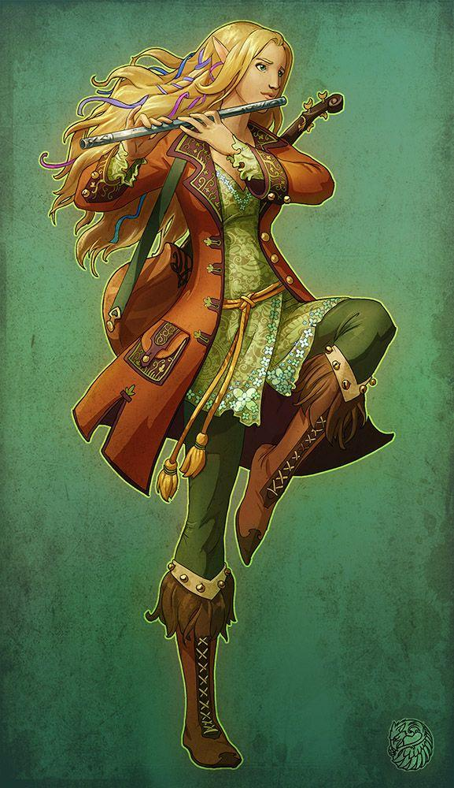
Notes:
1 - Antinua Dankil
2 - Adrik Dankil
3 - Adrik’s Animals
4 - Myev
5 - Ander High-Hill & Milo Silvereyes
6 - Eke
7 - Arveene Amblecrown

Slide 2
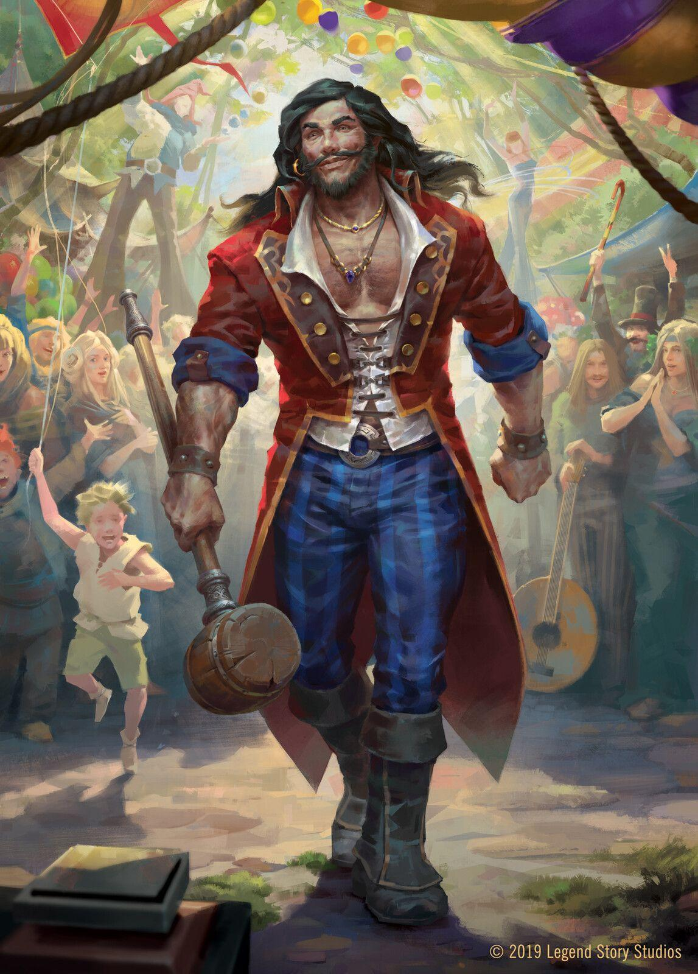
Notes:
1 - Antinua Dankil
2 - Adrik Dankil
3 - Adrik’s Animals
4 - Myev
5 - Ander High-Hill & Milo Silvereyes
6 - Eke
7 - Arveene Amblecrown

Slide 3
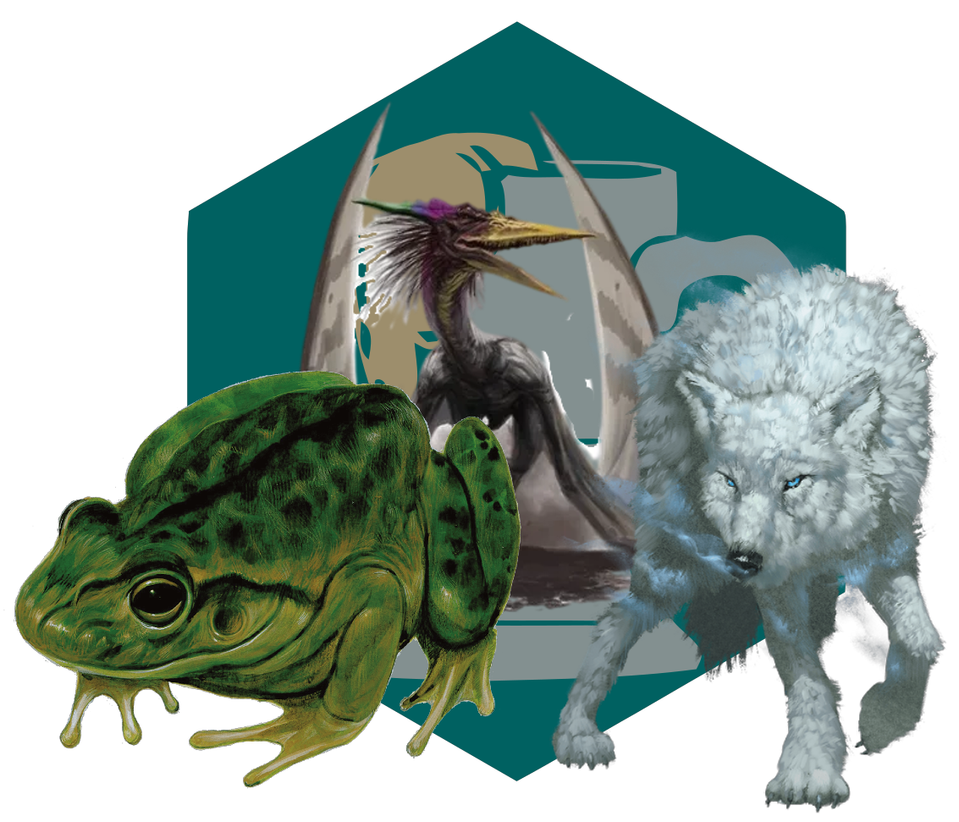
Notes:
1 - Antinua Dankil
2 - Adrik Dankil
3 - Adrik’s Animals
4 - Myev
5 - Ander High-Hill & Milo Silvereyes
6 - Eke
7 - Arveene Amblecrown

Slide 4
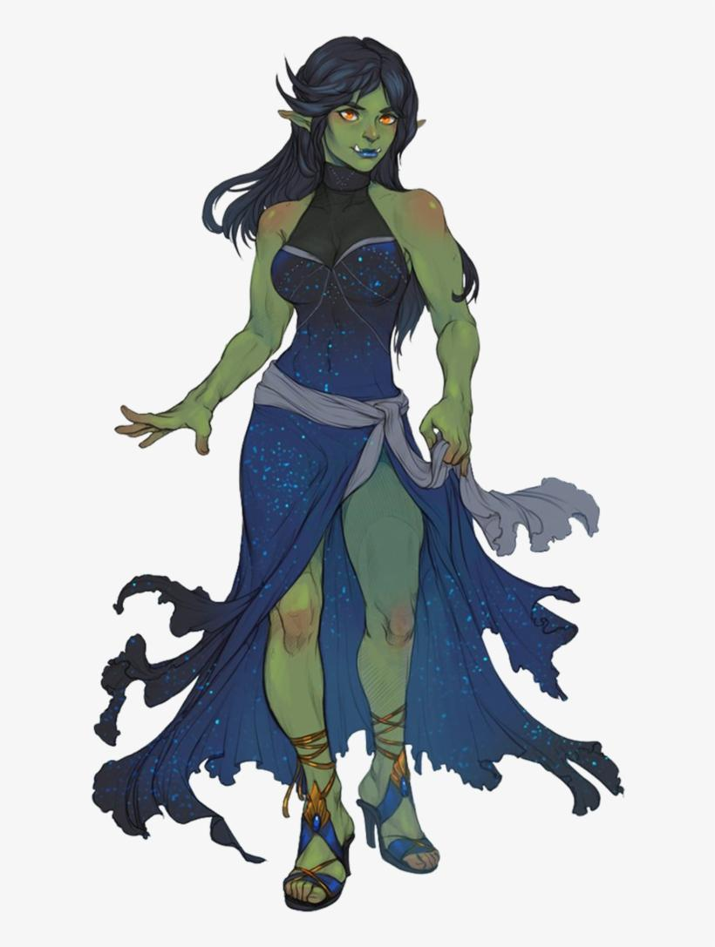
Notes:
1 - Antinua Dankil
2 - Adrik Dankil
3 - Adrik’s Animals
4 - Myev
5 - Ander High-Hill & Milo Silvereyes
6 - Eke
7 - Arveene Amblecrown

Slide 5
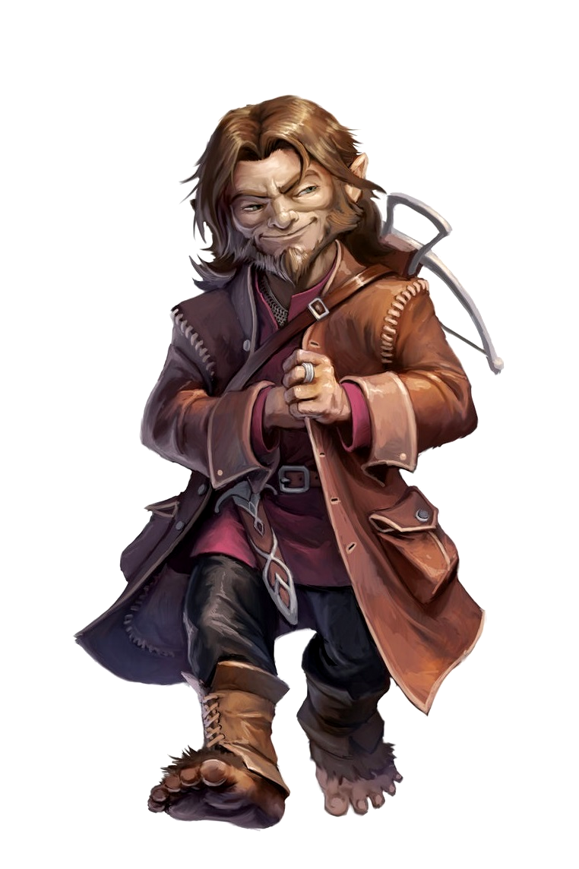
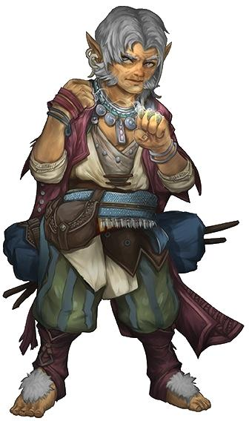
Notes:
1 - Antinua Dankil
2 - Adrik Dankil
3 - Adrik’s Animals
4 - Myev
5 - Ander High-Hill & Milo Silvereyes
6 - Eke
7 - Arveene Amblecrown

Slide 6
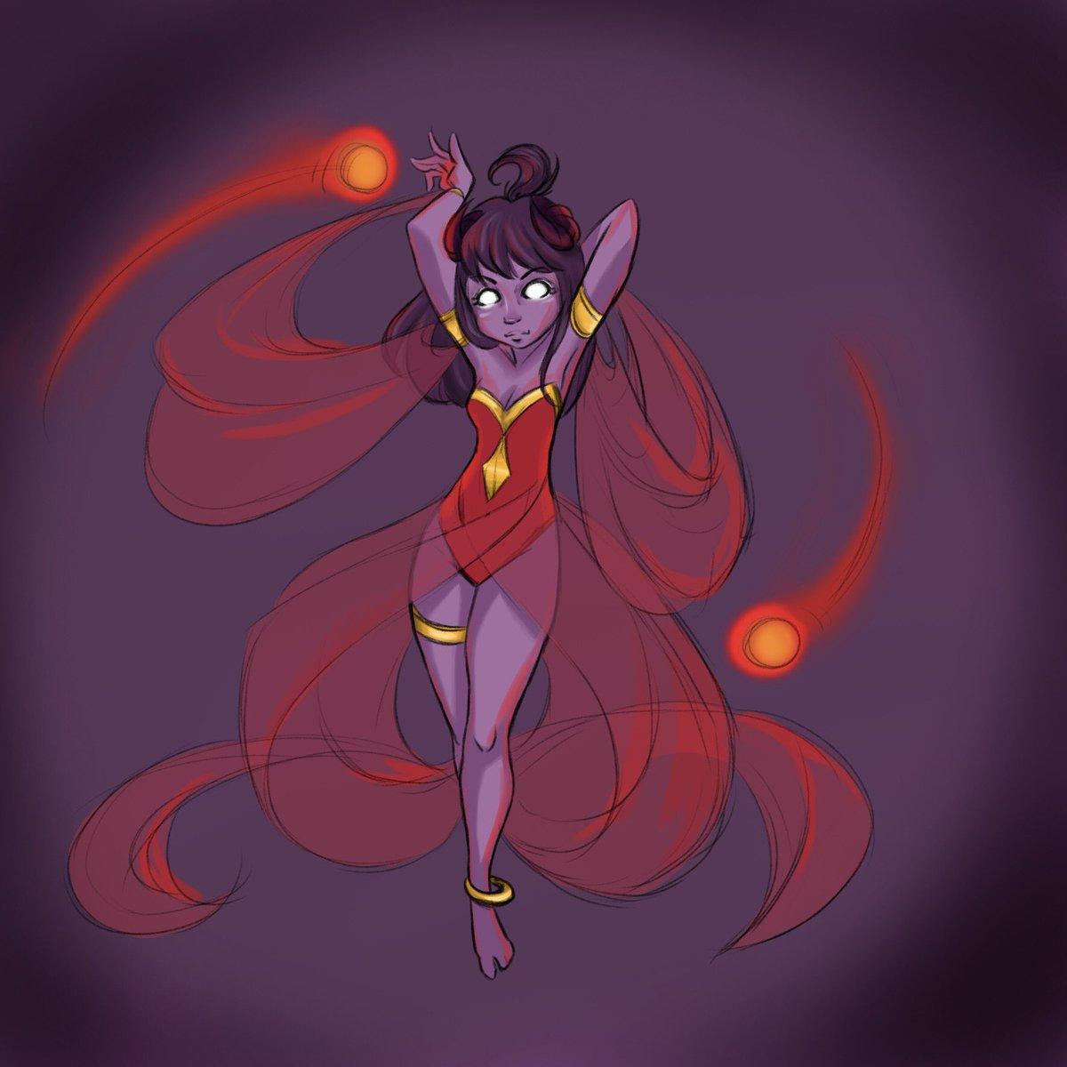
Notes:
1 - Antinua Dankil
2 - Adrik Dankil
3 - Adrik’s Animals
4 - Myev
5 - Ander High-Hill & Milo Silvereyes
6 - Eke
7 - Arveene Amblecrown

Slide 7
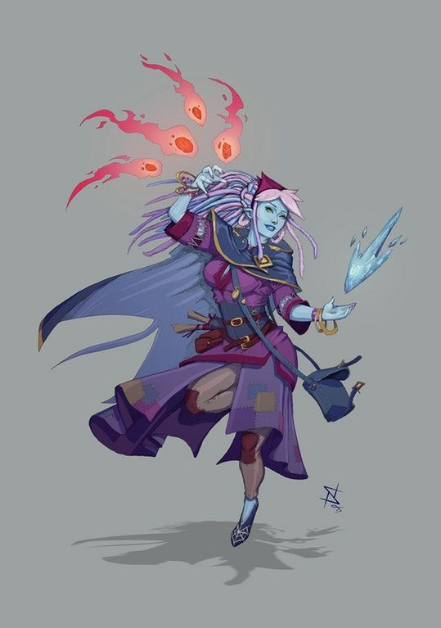
Notes:
1 - Antinua Dankil
2 - Adrik Dankil
3 - Adrik’s Animals
4 - Myev
5 - Ander High-Hill & Milo Silvereyes
6 - Eke
7 - Arveene Amblecrown

